Slide 1
《英语国家社会与文化入门》(下册）
The Society and Culture
of Major English-Speaking Countries
An Introduction
(Book Two)

Slide 2
The United States of America Unit 11 The American Way of Life

Slide 3
Quiz
Give the English and a brief explanation for the following:
布朗对教育署案例
“大熔炉”与美国万花筒
盎格鲁－撒克逊族裔的白人新教徒
“沙拉碗”
“美国梦”
富兰克林·罗斯福与社会正义
美国不断变化的国家形象
网络与言论自由
自由与平等的双重价值

Slide 4
Focal Points
the “melting pot” vs. American Mosaic
WASP
the "American Dream”
the US as a nation of immigrants
“the three faiths”
Franklin D. Roosevelt and social justice
the Internet and freedom of speech
the twin values of liberty and equality

Slide 5
The Unit Is Divided into Five Sections
I. One-Line Stereotypes about the USA
II. The USA as a “Melting Pot”
III. Alternatives to the “Melting Pot” as National Self-Image
IV. A 21st-Century Metaphor for American Life
The Ongoing Tensions between Liberty and Equality

Slide 6
I. One-Line Stereotypes about the USA
Stereotype 1: All Americans are rich.
The word stereotype came into English from French in the early 19th century.
The word has broadened its meaning to imply ideas that appear always the same because they are not open to any questioning.
One-line stereotypes greatly oversimplify American life, but often they are based on some partial insights.

Slide 7
I. One-Line Stereotypes about the USA
Stereotype 1: All Americans are rich.
- Like most countries in the world, the USA has a wide range of people from very rich to very poor.
-Over the last 40 years the percentage officially classified as living in poverty has fluctuated between 11% and 15% of the population.
-About 1% of the population are homeless people.

Slide 8
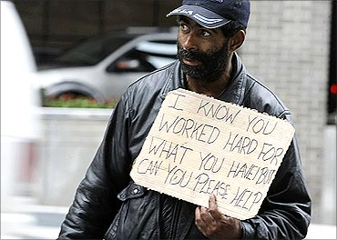
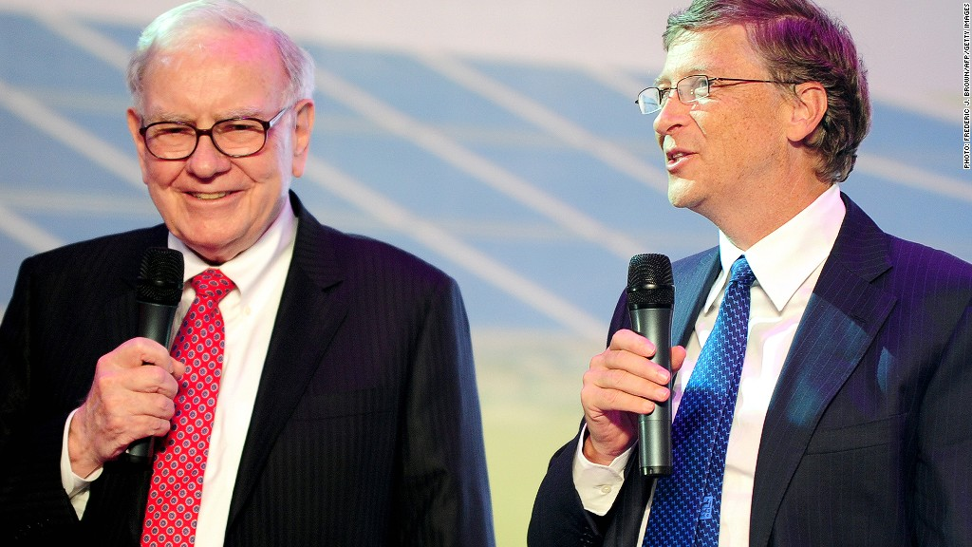
I. One-Line Stereotypes about the USA
Warren Buffett and Bill Gates rank first and second on Forbes' list of the 400 richest Americans.
A homeless person begs for help on the street.

Slide 9
Stereotype 2: American society is violent.
- Crime rates in the USA, despite sharp declines in recent years, remain notably higher than in other industrialized countries .
-About 1% of the population is in prison, the highest ratio in the world.
-Who commits crimes? Very often, underclass people who have poor prospects for jobs.
- Crimes are associated with guns, about 25% of Americans own a gun.

Slide 10
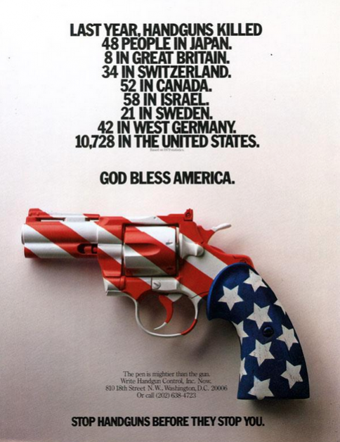
Stereotype 2: American society is violent.
Street fighting in a New York Neighborhood

Slide 11
Stereotype 3: American families are in disarray.
Before World War II, American families were dominated by the senior male as husband and father.
The newer, more egalitarian family after WWII are a “nurturing-parent” family, in which children were encouraged to think, act independently.
New “no-fault” divorce laws that are now nearly universal in American states, caused the divorce rate to rise to about 50%.
Shifting marriage patterns also cause many young people to listen to their peers more than to their parents.
As a long-term result, traditional values do not transmit readily from one generation to the next, leading to a polarized society.

Slide 12
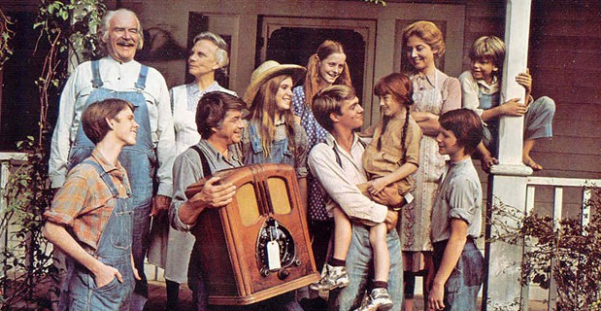
Stereotype 3: American families are in disarray.
Lost and gone forever: traditional American family

Slide 13
Stereotype 4: Americans are all religious.
Most Americans believe in God, one god only, in Judaism or Christianity or perhaps Islam, the three “religions of the book” that share one thing in common, a single creator.
Recent polls show that 85% of Americans say they believe in God.
However, it does not necessarily result in active participation in religious services; for many it is simply a cultural conviction.

Slide 14
Stereotype 5: Americans are optimistic.
An upbeat expectation dates back to the 17th century when the new Americans believed their New World with its way of life as morally exemplary.
Such a belief remains as an ongoing part of a national ideology in the form of the “American dream”
American Dream still inspires immigrants to come to the US to share in its national destiny.

Slide 15
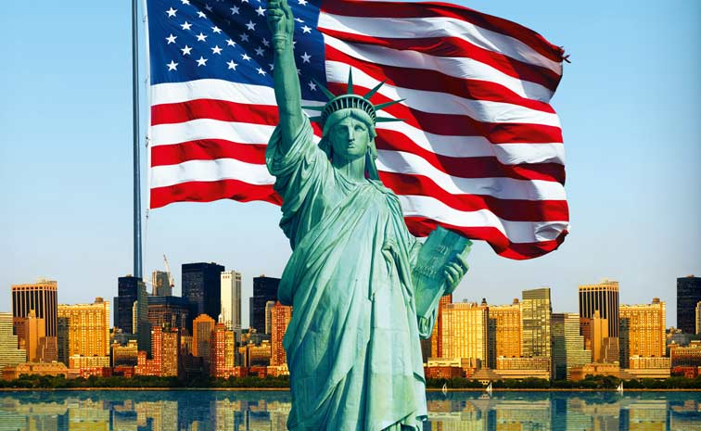
Stereotype 5: Americans are optimistic.
“America, the Beacon Light of Hope for all”

Slide 16
II. The USA as a “Melting Pot”
-The USA is a nation of immigrants.
-Starting in the early 17th century, immigrants have flooded into what is now the USA.
-the European and African diasporas of earlier years
-later Asia and Latin America contributing millions
-the dominant class from England
-in the 20th century, America self-defined as of the “the melting pot”
-the image dating back to a 1905 popular play produced by a Jewish playwright named Israel Zangwill

Slide 17
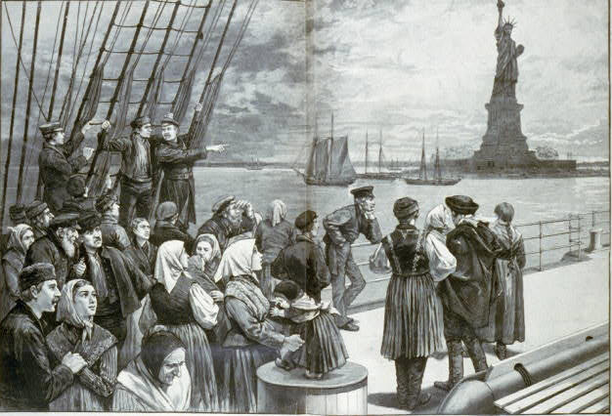
II. The USA as a “Melting Pot”
America as a nation of immigrants

Slide 18
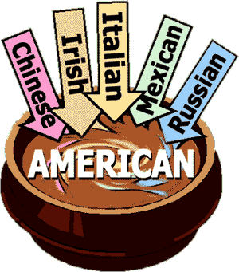
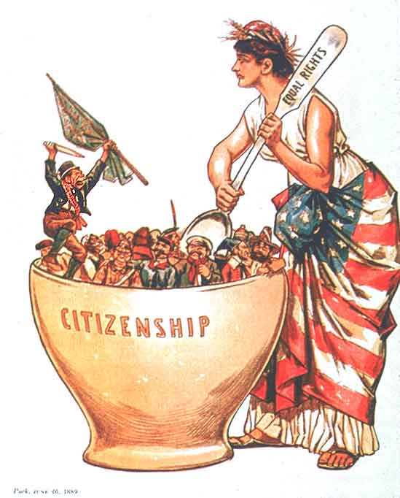
II. The USA as a “Melting Pot”
A new nation with people of diverse backgrounds

Slide 19
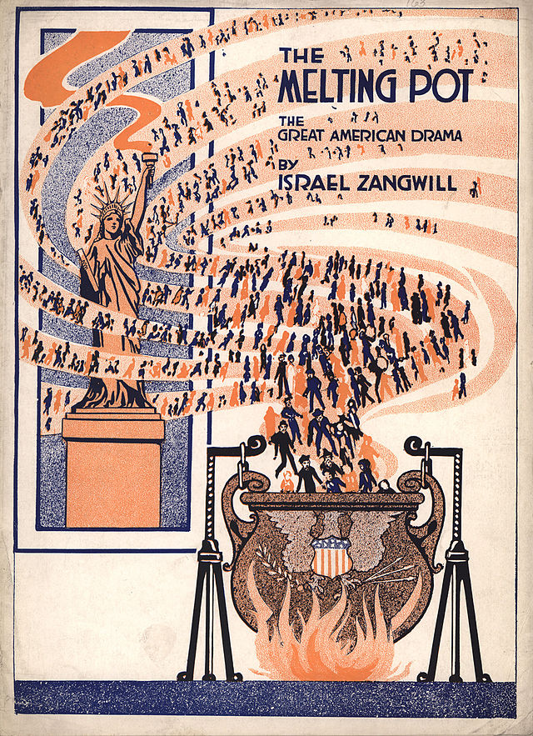
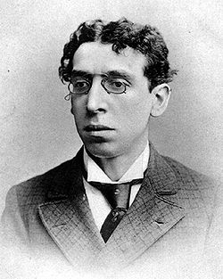
II. The USA as a “Melting Pot”
Israel Zangwill (1864–1926) was a British humorist and writer.

Slide 20
II. The USA as a “Melting Pot”
The values associated with WASPs are to be found in the classic words of Thomas Jefferson in the Declaration of Independence (1776): “life, liberty, and the pursuit of happiness.”
Traditional values that fed into the "American Dream” are: hard work with confidence of success, self-reliance paired with trust in God.
WASPs dominated American life through the 19th century until they were seriously challenged and WASP centrality began to diminish in the middle of the 20th century

Slide 21
III. Alternatives to the “Melting Pot” as National Self-Image
With the melting pot metaphor losing its credibility, Culture critics and students of American Studies sought to replace it with a new one multicultural.
The first alternative to gain credibility was “salad bowl,” as a national self-image, with components which retained its characteristic flavor, color and texture.

Slide 22
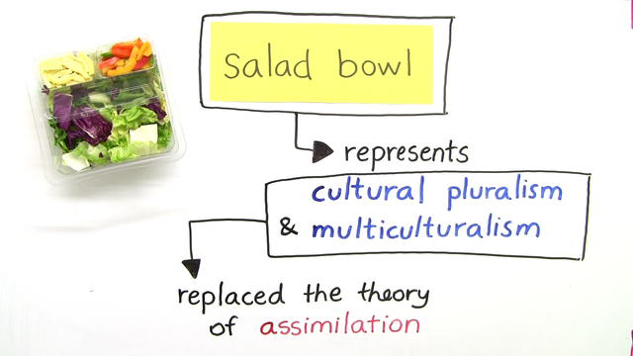
III. Alternatives to the “Melting Pot” as National Self-Image
The melting pot metaphor is replace by a new one that indicates multicultural.

Slide 23
III. Alternatives to the “Melting Pot” as National Self-Image
Mosaic emerged to avoided the problems of the “salad bowl” because, once the pieces were glued in place, they did not decay.
But there is one fatal flaw in this metaphor. The mosaic never changes, which seems unacceptable.
Late in the 20th century, some tried to explain the USA as a kaleidoscope which reflected the many different groups that have gone into making up the American population.
However, if one’s nation were that changeable, how could anyone take it seriously?

Slide 24
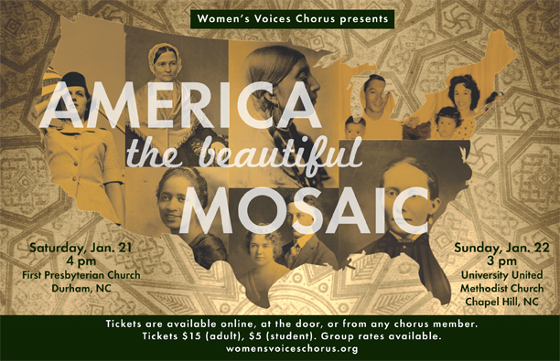
III. Alternatives to the “Melting Pot” as National Self-Image
Mosaic as America’s national self-Image.

Slide 25
IV. A 21st-Century Metaphor for American Life
An up-to-date metaphor that seems to be able to encapsulate the USA: the Internet.
The Internet has several characteristics that are in tune with the USA today: the WWW has no center;
No one is in charge;
Each individual must take responsibility for what he or she takes seriously:
All of them important features of the American way of life.

Slide 26
IV. A 21st-Century Metaphor for American Life
The World-Wide-Web began in the USA as a Cold War military innovation driven by fear of possible atomic attack.
By the 1990s, the WWW broadened out into general and commercial use.
In the USA, anyone can post anything he or she wishes on the Internet. Hence it offers great liberty (or freedom), one of the original American values.

Slide 27
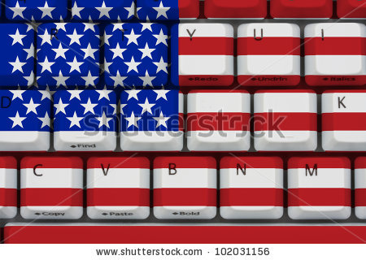
IV. A 21st-Century Metaphor for American Life
The World-Wide-Web began as a US Cold War military innovation.

Slide 28
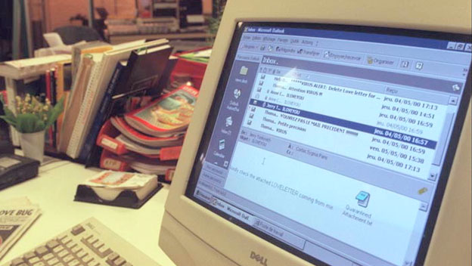
IV. A 21st-Century Metaphor for American Life
By the 1990s, the WWW broadened out into general and commercial use.

Slide 29
IV. A 21st-Century Metaphor for American Life
There is no censorship of the Internet in the USA, but there are laws that punish the abuse of the Internet.
The Internet can thus serve noble purposes or base purposes. It can educate or misinform, or simply offers a vast pool of advertising.
The WWW is individualistic and democratic.
One major limitation in the Internet as a self-image for life in the USA today, namely, its total lack of direction.

Slide 30
V. The Ongoing Tensions between Liberty and Equality
To Westerners, liberty, and its functional equivalent, freedom, both signify liberation from constraints.
Freedom characterizes the condition of the citizens of Athens as opposed to its slaves.
Liberty came from the Latin adjective meaning free. By the 18th century, especially in France, liberté was the rallying cry of all those who sought freedom from the hereditary authority of the king, the nobles, and the Catholic Church.

Slide 31
V. The Ongoing Tensions between Liberty and Equality
The expressions equality and social justice may be used interchangeably by many Western thinkers.
Social justice implies that even the lowest classes must be treated fairly, ideally with equality.
In the USA, “level playing field,” implies that the processes of competition between individuals should not be tilted in favor of any particular group, either for or against.

Slide 32
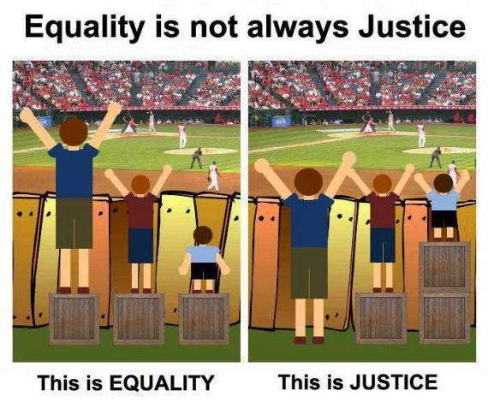
V. The Ongoing Tensions between Liberty and Equality
There is a yawning gap between equality and justice

Slide 33
V. The Ongoing Tensions between Liberty and Equality
The principle of liberty-freedom may easily conflict with that of equality-social justice.
The two political parties-the Republicans and the Democrats- have usually been divided between conservatives (who privilege the values of freedom-liberty) and progressivists (who want values of equality-social justice to predominate).
The USA as a nation will continue to live with this fundamental tension and its consequences.

Slide 34
Conclusion
It is hard to epitomize the USA to outsiders who would like a quick phrase or two to make general statement.
Tension will continue between the twin values of liberty and equality.
Such is the American way of life.

Slide 35
Questions for Discussion
A. What does it really mean to describe the USA as a nation of immigrants?
B. What seems to be the fatal flaw in the metaphor of America as a “mosaic”?
C. What is the most up-to-date metaphor that now might be used to encapsulate the USA? What was its origin?
D. Why did the author say the open-endedness of the Internet fits well the current phase of American life?
C. How does the author use the climate crisis as an example to illustrate how and why Liberty versus Equality?

Slide 36
The End
高等教育出版社
2015

